Slide 1

Twimintel.ai
Intelligence discovery made easy

Slide 2


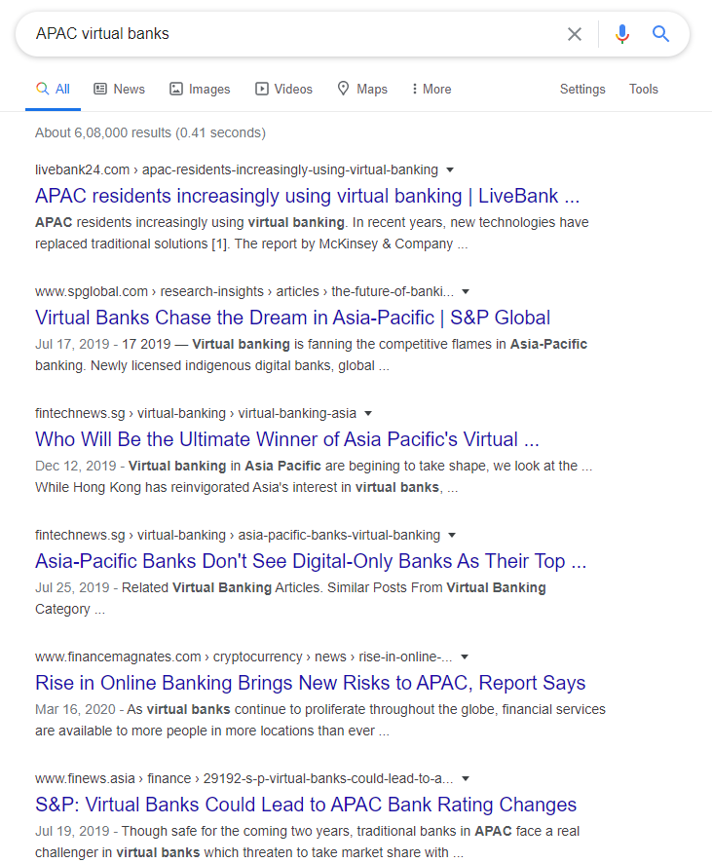
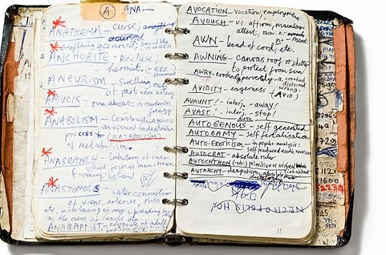
Problem
Analysing vast amount of data
Find true fact from the information
Context loss in heap of data
Time consuming and labour intensive process

Slide 3

Twimintel.ai
It’s a system of ML and AI tools that process vast amount of textual and statistical information to generate them as simplifies context based intelligence

Slide 4
Objectives
Simple way to log and manage ongoing research
Add relevant links to the knowledge corpus
Visualize the information that makes senses
Match information against supplied keyword to find relevance
Get answers to the problem statement
Self improve the system with feedback driven approach

Slide 5

Approach
We are using the power of NLP ( Natural language processing ) and NLU( Natural language understanding ) to analyze vast amount of information and keep improving the corpus of our information
Supported by -
NLP based text crawling
Word 2 vec/wordnet based embedding of the information
Gensim to find similarity
AlleNLP to find answers
GA to improve ML models

Slide 6
Process

Slide 7
Log the information
Collect all the relevant links and add it to our query base
Research analyst open all relevant tabs in there browser related to the query
Using a extension, they collect and save all those tabs to our system with keywords and problem statement
Tabs
keywords
Problem Statement
Logged to batch

Slide 8
Analyse the Links
Crawl
text
html
images
Parse
Embedding
Store
models
vectors

Slide 9
Match the information against keywords
Similarity
Match keywords
Answers
Find Answers to Problems
Stats
Correlated information
Media
Find relevant media
Distance
Provide Claim

Slide 10
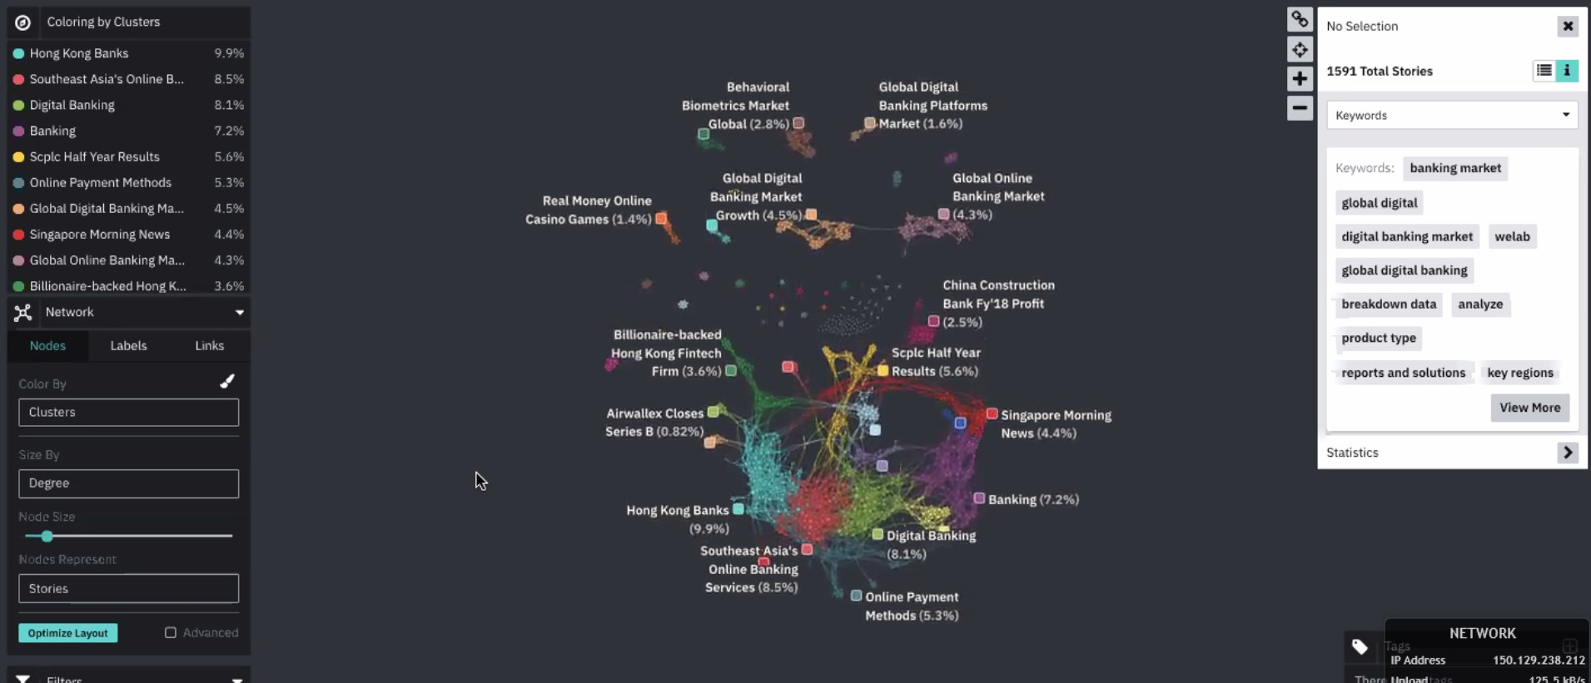
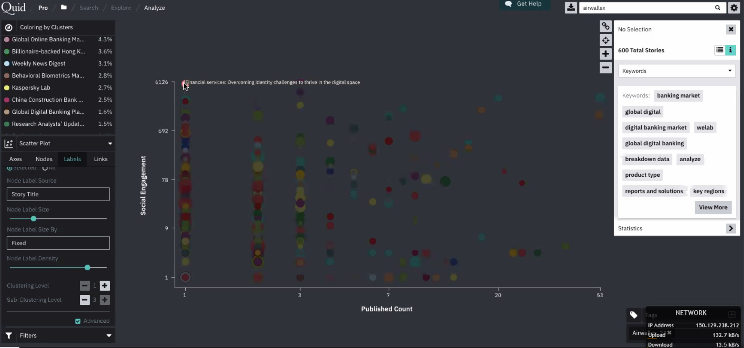
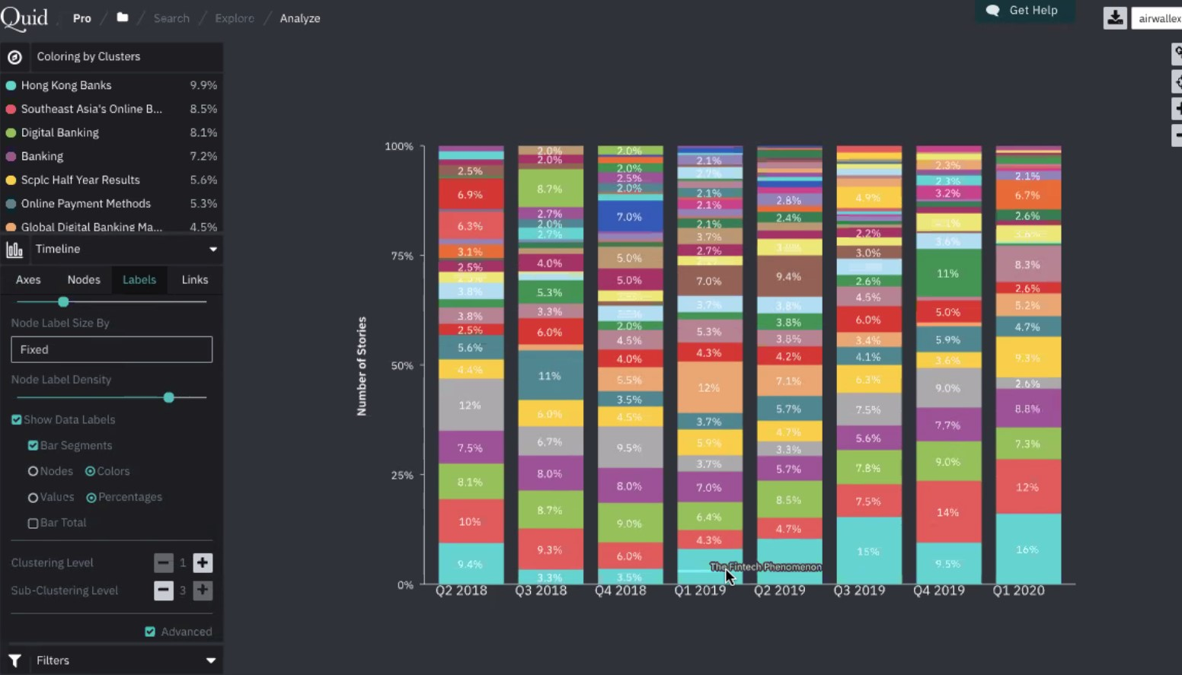
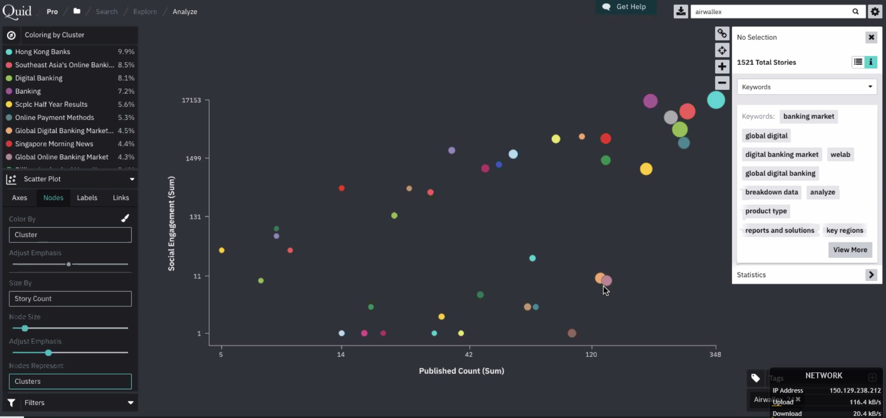
Visualize the information

Slide 11
Improving the system
Expand the corpus
Improve the models
New Query Data
Discard non relevant data
Add new relevant links to corpus
Feedback 1 model
Feedback 2 model
Better model

Slide 12
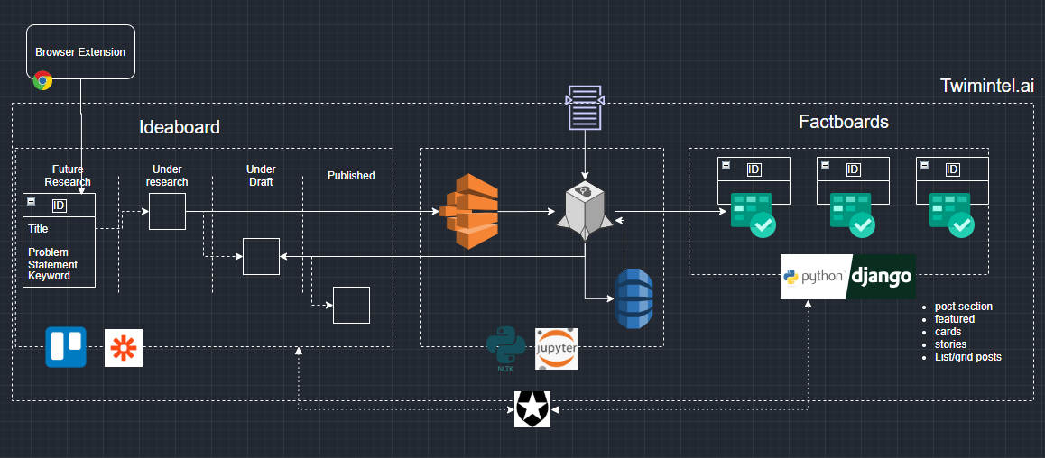
The whole process flow

